Slide 1
Lecture 1: COMP1010 Introduction to Programming
Course content, organization and basic concepts
Kok-Seng Wong | Fall 2021

Slide 2
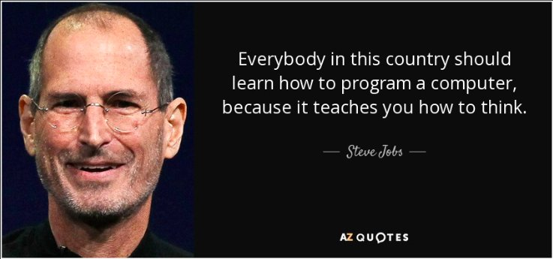
[source]

Slide 3
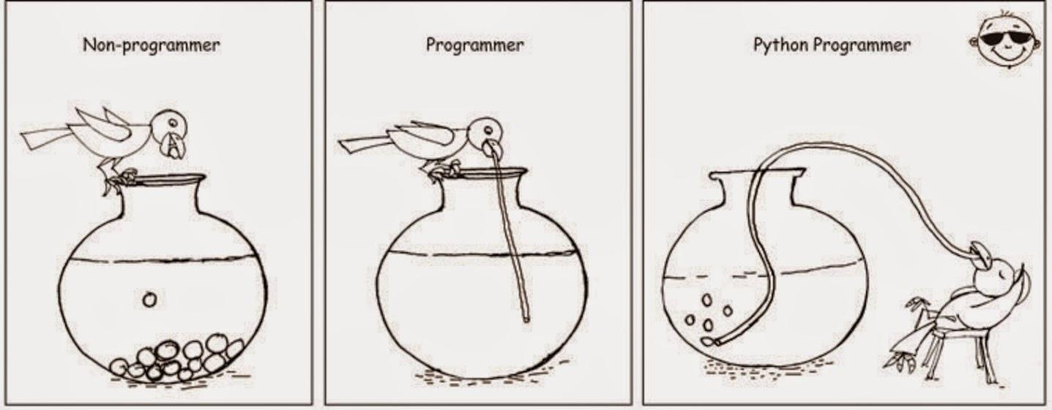
Motivation example 1
source

Slide 4
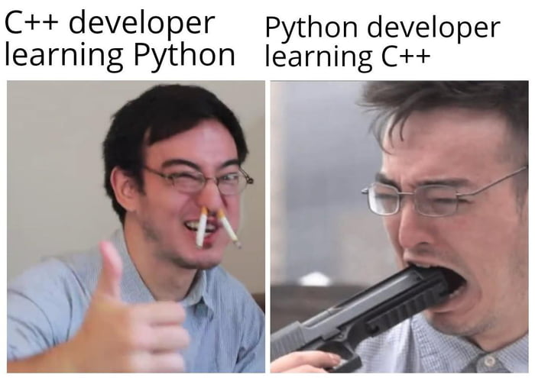
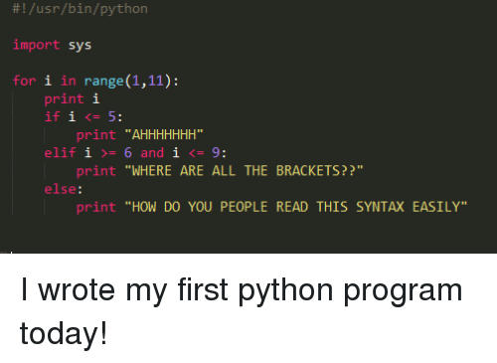
Motivation example 2
source

Slide 5
Course content and organization

Slide 6
Course description
Course Info: 4 credits, required course, no prerequisite/co-requisite/exclusion courses.
This course is an introductory programming course taught to all students.
Rationale: This course provides students with the basic programming skills and a basic understanding of the design of programming languages.

Slide 7
Learning goals
Understand and apply the basic concepts of programming including variables, classes, loops, functions, arrays, vectors, exceptions and the basics of object-oriented programming and graphical user interfaces.
Acquire fundamental programming skills required to engage in more complex computer science topics.
Develop the ability to solve conceptual and application-based computing problems via regular practice, both in and out of class.

Slide 8
Key advantages of python
Python has risen in the ranks of programming languages.
Easy to learn and readable syntax.
Diverse community that opens new opportunities.
Python has extensive libraries and frameworks.
Further reading: https://www.nextacademy.com/blog/learn-python-first/

Slide 9

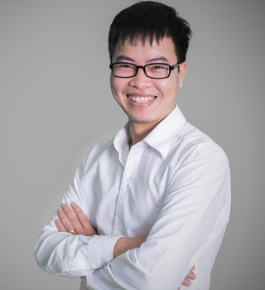
Instructors
Instructor: Kok-Seng Wong (wong.ks@vinuni.edu.vn)
Lab Instructor: Pham Huy Hieu (hieuhuy01@gmail.com)

Slide 10
Class schedules
Lecture
Laboratory
Group | Day & Time | Venue
All students | Monday: 3.30pm - 4.45pm | G104
 | Tuesday: 3.30pm - 4.45pm | G104
Group | Day & Time | Venue
1 | Thursday : 9.00am - 10.50am | G102 (SuperLab)
2 | Thursday : 11.00am - 12.50pm | G102 (SuperLab)

Slide 11
Office hours
Group | Day & Time | Venue
All students | (Practical) Wed: 4.00pm - 5.50pm | TBA
 | (Theory) Thurs: 2.00pm - 3.20pm | TBA
Online Mode: make an appointment with the instructor via email -one day in advance.
Offline Mode: visit the designated room -no appointment needed.

Slide 12
Specific learning objectives
By the end of this course, students will:
Be able to use a programming language constructs such as primitive types, and classes.
Be able to understand the basics of object-oriented programming, algorithms and data structures.
Be able to work with function calls.
Be able to create and understand recursive functions.
Be able to work with arrays, lists and dictionaries.
Be able to work with strings.
Be able to develop basic graphic user interfaces.
Be able to choose an adequate programming style and write good code.

Slide 13
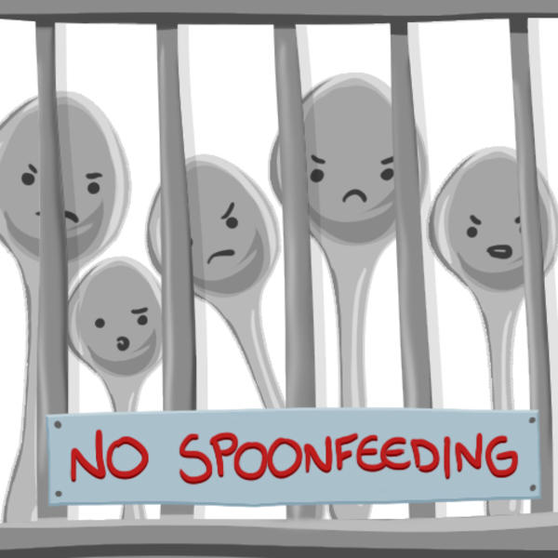
Active learning methods
The class follows an active, blended, and team-based learning:
How to Live Together
Learning by Teaching
Tools:
Canvas
Quizizz (https://quizizz.com/join?class=E810169)
During laboratories, students engage in program development and discussion with instructors who facilitate the laboratory work.

Slide 14
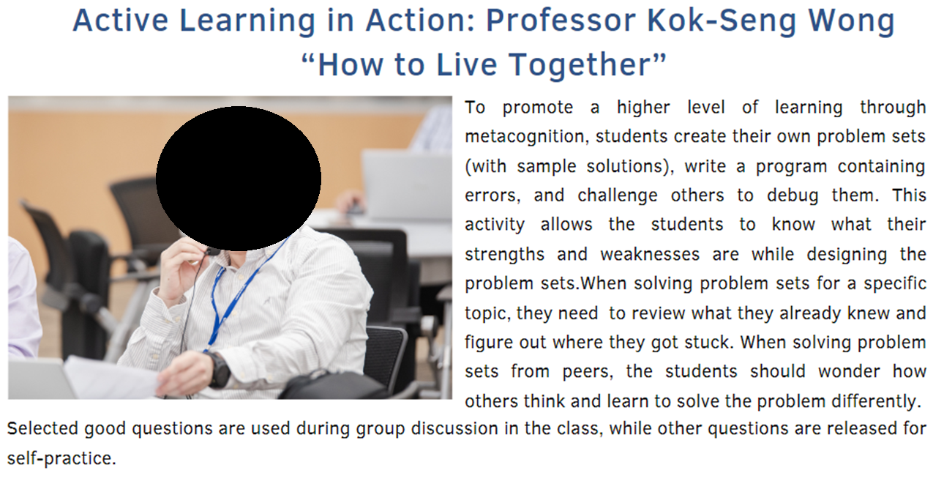

Slide 15
Course logistics
Lectures will be held in a lecture room with at least two projectors of high quality.
The course will utilize an LMS (learning management system), such as Canvas, for the blended learning component.
A course website for course announcements and course material distribution will be made available.
In laboratories, students use the programming environment of their choice (the Anaconda version of Python is suggested, but the instructor will make that final choice at the beginning of the semester).

Slide 16
Late submission policy
Late submission of lab practices without an approved extension will incur the following penalties:
No submission by the deadline will incur a 0.25-point deduction for each problem (most of the problems are due at the end of the lab session).
The instructor will deduct an additional 0.25 point per problem for each day past the deadline.
The penalty will be deducted until the maximum possible score for the lab practice reaches zero (0%) unless otherwise specified by the instructor.

Slide 17
Course requirements
Class attendance, participation and etiquette policies:
Students are strongly encouraged to participate in lectures, and laboratory attendance is mandatory.
Students are expected to continually prepare for participation in lectures and laboratories by mastering previously taught concepts.
They are expected to collaborate with the instructors and other students and participate in a wide range of educational activities and help and encourage their peers to master the course contents.

Slide 18
Instructor expectations (1/2)
1. Classroom behavior:
You are expected to act respectfully towards your fellow classmates, TAs, and instructors inside and outside of the classroom.
We have a limited amount of time to cover a lot of material this semester, so you need to pay attention during lectures and laboratories and participate in class practice when it is assigned.
Talking on your phone, texting, chatting online, browsing Facebook or other social media sites, and talking excessively with your neighbors about non-class related stuff are just a few examples of behavior that is not acceptable, and will negatively impact your class concentration.

Slide 19
Instructor expectations (2/2)
2. Attendance:
Students must report all absences for health reasons to the Department of Student Affairs.
It is the student’s responsibility to understand the material covered when there is an absence.
Students are expected to arrive to class on time.
3. Language:
English is the official language of instruction for this university; therefore, all works are expected to be done neatly and accurately in English.
4. Electronic Devices:
All mobile phones and other related electronic personal communication devices must be turned off during class.
Laptops or tablets can be used for taking notes or finding relevant information on the Internet.

Slide 20
Student responsibilities regarding AI
Read, understand, and follow all aspects of the academic integrity policy in all their university interactions.
Read, understand, and follow any special instructions from their course instructor regarding academic integrity requirements.
Sign the Academic Integrity Statement at the beginning of each academic year.
When required by the instructor, submit assignments using Turnitin, the university’s plagiarism detection software.
Not participate in, support, or assist in any behavior that could constitute a violation of academic integrity.
When in doubt about any aspect of academic integrity requirements, consult the course instructor, academic advisor, program director, or another trusted university official.
When reporting any violations of academic integrity, present full, truthful, and credible evidence supporting the allegation.
When called upon by university officials to contribute to an ongoing investigation of academic integrity violation, provide, complete, truthful information, and maintain complete confidentiality.

Slide 21
Course readings
Downey, A. B. (2015) Think Python: How to Think Like a Computer Scientist. Retrieved from greenteapress.com
Guttag, J. (2016) Introduction to Computation and Programming Using Python: With Application to Understanding Data. USA: MIT Press.

Slide 22
Grading procedures
Item | Assessment Method | % Weighting
1. Quiz and Attendance | Online Quizzes (Theory) | 20%
2. Assignment | Pre-recorded Videos & Problem Sets Design | 15%
3. Laboratory | Programming Practices | 25%
4. Midterm Exam | Hands-on (Practical) | 20%
5. Final Exam | Hands-on (Practical) | 20%
Total |  | 100%

Slide 23
Laboratory assessment
Laboratory | % Weighting
1 | -
2 | 2%
3 | 2%
4 | 2%
5 | 2%
6 | 2%
7 | 2%
8 | 2%
9 | 2%
10 | 2%
11 | 2%
12 | 2%
13 | 3%
Total | 25%

Slide 24
Grading scheme
Grade | Range
A | 100% | to 89.5%
A- | <89.5% | to 84.5%
B+ | <84.5% | to 79.5%
B | <79.5% | to 74.5%
B- | <74.5% | to 69.5%
C+ | <69.5% | to 64.5%
C | <64.5% | to 59.5%
C- | <59.5% | to 54.5%
D+ | <54.5% | to 49.5%
D | <49.5% | to 44.5%
D- | <44.5% | to 40.0%
F | <40.0% | to 0.0%

Slide 25
Proficiency exam
When appropriate (and only for first-year courses), the course instructor can offer proficiency exam near the beginning of the semester to allow student to demonstrate their proficiency of all course learning objectives as stated in the course syllabus.
If the student passes the proficiency exam, he/she can obtain the equivalence of the transfer credit.
Date: Wednesday, Sept 29, 2021 (4.00 PM – 5.50 PM)
Topics: Week 2 to 13
Please complete the background survey before/on Sept 23 in Canvas.

Slide 26
Independent study
1 to 3 credit hours per semester; may be repeated; are applied as elective credits only)
There should be an Individual Study Form (PDF or online – Appendix 2) that the student has to submit within the first 8 weeks of the semester and obtain the agreement from a VinUni faculty, who serves as the course instructor for this student’s Individual Study course.
The Individual Study form contains the title, outline, and description of the project that would be conducted by the student for this Individual Study course. The agreed instructor would have to submit a grade for the Individual Study course at the end of the semester like for a regular course.
The expected workload, as for other regular courses, is 3 times the number of signed up credit hours, per week on average.
The expected deliverables at the end of the semester are either a presentation at the Undergraduate Research Symposium and/or a project report as specified by the course instructor.

Slide 27
Introduction to computer systems
Hardware, Software, Components of a Computer System

Slide 28

Computer hardware
The physical parts of the computer.
[source]

Slide 29
Computer software
The programs and data used with the physical computer:
System software
Application software
Utilities software
Computer security

Slide 30
Major components of a computer system
Processor
Main memory
Secondary memory
Input devices
Output devices

Slide 31
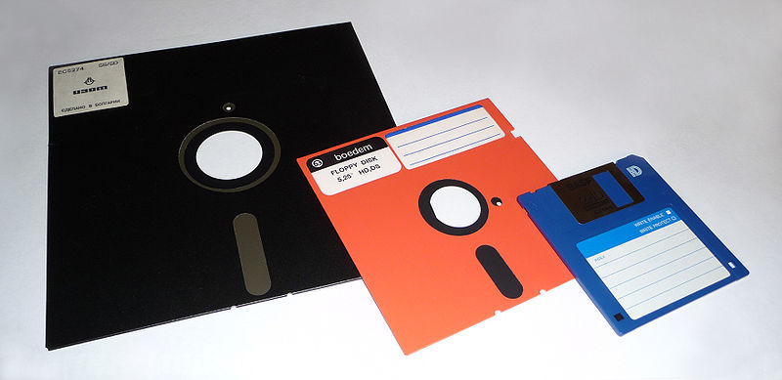
Disk storage (floppy disk/diskette)
[source]

Slide 32
What is a Program?
A program is a sequence of instructions that specifies how to perform a computation.
input
output
math/logic
conditional execution
Repetition/recursion

Slide 33
Types of programs
Application Programs | Systems Programs
Word processors Games Spreadsheets Database systems Graphics programs Web browsers | Operating system Networking system Programming language software Website server Data backup

Slide 34
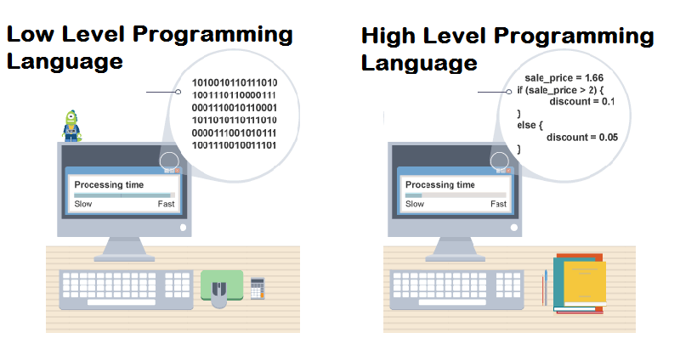
Programming language
assembly language, machine languages
C, C++, Perl, Java, Python, …
[source]
Computers can only execute programs written in low-level languages.
Thus, programs written in a high-level language have to be processed before they can run.

Slide 35
Low-level vs high-level
Programs written in a high-level language
Less time to write
Shorter and easier to read
More likely to be correct
Portable: can run on different kinds of computers with few or no modifications. Low-level programs can run on only one kind of computer and have to be rewritten to run on another.

Slide 36
Interpreter vs. compiler

Slide 37
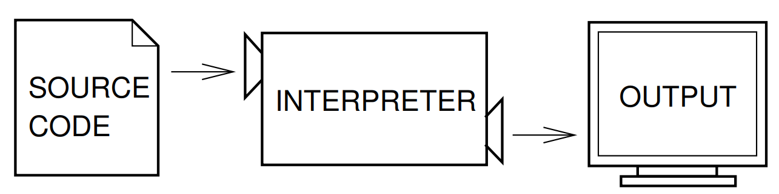
Interpreter
An interpreter reads a high-level program and executes it, meaning that it does what the program says.
It processes the program a little at a time, alternately reading lines and performing computations

Slide 38
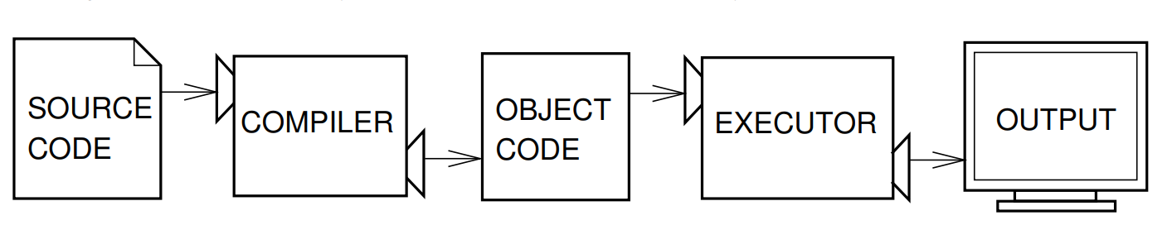
compiler
A compiler reads the program and translates it completely before the program starts running.
In this case, the high-level program is called the source code, and the translated program is called the object code or the executable.
Once a program is compiled, you can execute it repeatedly without further translation.

Slide 39
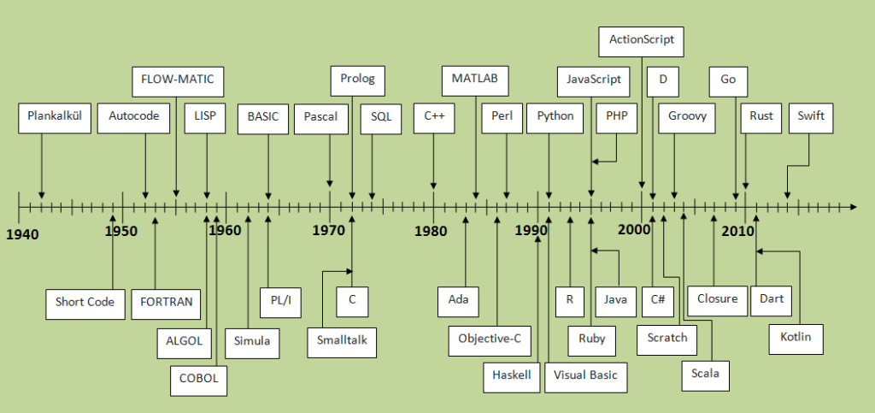
Timeline of programming languages
[source]

Slide 40

[source]

Slide 41
History of python
Python – named after British comedy group Monty Python
Developed by Guido van Rossum in Netherlands.
It supports object-oriented, imperative, functional and aspect-oriented programming styles.
Python is extensively used in web development, information security and artificial intelligence.
Reddit, a social news networking site is entirely written in Python.
Other companies that use Python are Google, Yahoo, Amazon, Instagram and NASA.
More on WIKIPEDIA: https://en.wikipedia.org/wiki/History_of_Python
[source]

